Slide 1
HTML Document Structure
Introduction to HTML & Elements | HTML document | Viewing a page's HTML | HTML validator
Notes:
Welcome to our lecture on Basic HTML elements. In this lecture we will go through the introduction to html and html elements, HTML document structure, how to view html page in browser, and will go through html validators. So let’s start.

Slide 2

Introduction to HTML
HTML stands for Hyper Text Markup Language, used for creating webpages.
Hyper Text: Text with links to other documents or resources.
Markup: Defines the structure and meaning of different parts of the document.
Language: A set of rules for writing HTML code properly.
Notes:
HTML is the foundation of creating webpages. It stands for Hyper Text Markup Language, where Hyper Text refers to text containing links to other documents or resources. Markup defines the structure and meaning of different parts of a document. Lastly, Language represents the set of rules for writing HTML code properly. Together, these elements enable the creation of structured, interactive web content.

Slide 3
Introduction to HTML Elements
HTML has over 130 elements, each representing a single HTML structure.
HTML elements are represented using tags.
A tag consists of <, the tag name, and >.
Notes:
HTML consists of over 130 elements, with each element representing a specific structure in a webpage. These elements are defined using tags, which are fundamental to HTML. A tag is made up of three parts: the less-than symbol, the tag name, and the greater-than symbol. These simple components form the foundation for creating structured and functional webpages.

Slide 4
Introduction to HTML Elements
Opening tags indicate where an element starts.
Closing tags indicate where an element ends.
Example: <strong>Hello</strong> displays "Hello" in bold (strong weight) font.
Notes:
The opening tags define where an HTML element begins, while closing tags indicate where it ends. Together, they enclose content to apply specific formatting or functionality. For example, <strong>Hello</strong> displays the word Hello in bold or strong weight font. These tags are essential to structuring and styling elements on a webpage.

Slide 5
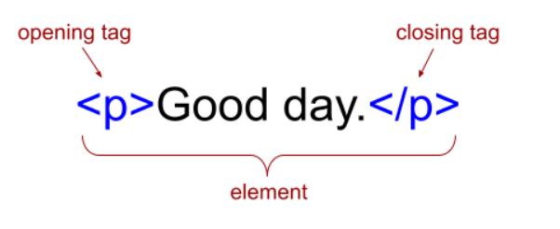
Example of HTML Tag & Element
Notes:
This diagram illustrates an HTML element. The opening tag p marks the start of the paragraph element, while the closing tag back slash p marks its end. Together, these tags enclose the content, Good day forming the complete element. This structure is key to defining and organizing content on a webpage.

Slide 6
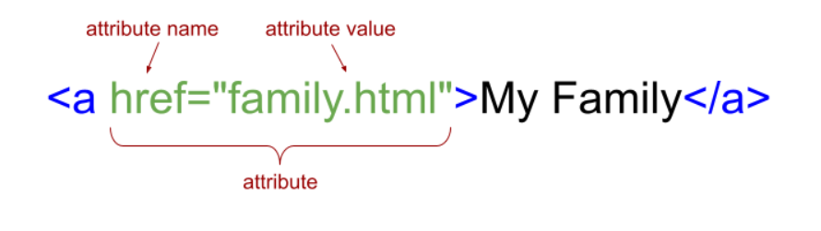
Attributes of HTML Elements
An element attribute provides additional information about the element and is included only in the opening tag.
Notes:
Now move on to Attributes in HTML that provide additional information about an element and are included in the opening tag. For example, in the anchor tag href family.html, href is the attribute name and family.html is the attribute value. Together, they specify the hyperlink destination. Attributes enhance elements by adding functionality or details.

Slide 7
HTML document
<!DOCTYPE html>: Declares the type of document for the web browser.
<html>: Encloses the entire document except the <!DOCTYPE> declaration. <html lang="en"> specifies English as the language.
<head>: Contains the title, metadata, and other non-visible webpage elements.
<meta>: Provides metadata about the document. Example: <meta charset="UTF-8"> defines character encoding.
Notes:
The HTML document starts with DOCTYPE html, which tells the browser the type of document. The html tag wraps the entire content, with lang equals to en specifying English language. The head tag contains the title, metadata, and non visible elements. The meta tag provides additional data like character encoding, as seen in meta charset UTF 8. These elements structure the document for browsers.

Slide 8
HTML document
Additional <meta> tags can describe the author, save date, etc.
<title>: Specifies the document's name, displayed in the browser's title bar and used by search engines/bookmarks.
<body>: Encloses all visible content and elements rendered in the browser.
Notes:
Additional meta tags provide information like the author or save date. The title tag specifies the document's name, which appears in the browser's title bar and is used by search engines and bookmarks. The body tag encloses all visible content and elements rendered in the browser. These tags ensure a well-structured and functional HTML document.

Slide 9
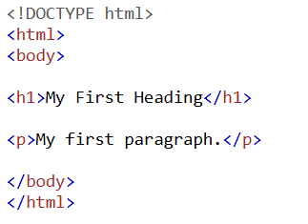
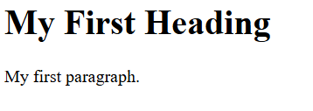
Example of HTML Document Structure
Notes:
This example shows the basic structure of an HTML document. The DOCTYPE html declares the document type. The html tag wraps the content, attribute lang specifying the language. Inside the head tag, meta charset UTF-8 defines character encoding, and the title tag sets the title as My First Webpage. The body tag contains the visible content, Hello World which is rendered in the browser.

Slide 10
Viewing a page's HTML
View webpage HTML via "View page source" or shortcuts Ctrl+U (Windows) / command + Option+U (Mac).
Search browser-specific instructions for details.
HTML may be complex due to CSS and JavaScript.
Notes:
Now discuss how to view a webpage's HTML, use View page source or shortcuts Ctrl plus U for Windows and Command plus Option plus U for Mac. You can also search for browser specific instructions if needed. Keep in mind that the HTML might appear complex due to additional CSS and JavaScript included in the webpage.

Slide 11
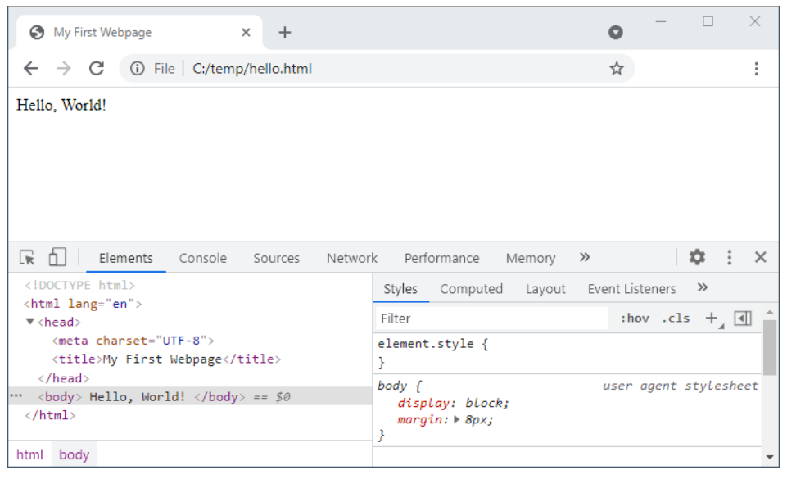
Chrome Dev Tools showing page's elements
Notes:
This is the example to view html page using Chrome Dev Tools that allows you to inspect a webpage's elements and view its structure. By right clicking on a page and selecting Inspect, you can see the HTML, CSS, and styles applied to elements. This tool is useful for debugging, testing, and learning about how a webpage is constructed and styled in real time.

Slide 12
HTML validator
Some elements like <center> are deprecated and no longer recommended.
Deprecated features are replaced by better, safer alternatives.
Invalid HTML can lead to unpredictable browser behavior.
Use tools like W3C Validator to ensure HTML meets standards.
Notes:
Finally dive into some HTML elements, like center, that are deprecated and should not be used. Deprecated features are replaced with safer and more modern alternatives. Invalid HTML can cause unpredictable browser behavior. Tools like W3C Validator help ensure your HTML follows standards and works as expected across browsers. Thanks for watching lecture.

